Slide 1
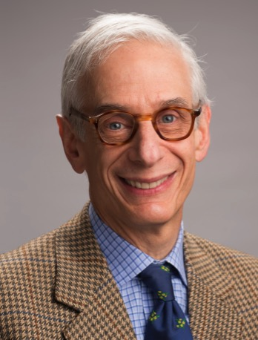
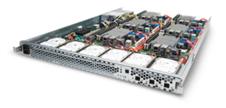
CS 61C: Great Ideas in Computer Architecture (a.k.a. Machine Structures) Lecture 1: Course Introduction
Instructors:
Krste Asanović, Randy H. Katz
http://inst.eecs.berkeley.edu/~cs61c/

Slide 2
Agenda
Thinking about Machine Structures
Great Ideas in Computer Architecture
What You Need to Know About This Class
Everything is a Number

Slide 3
Agenda
Thinking about Machine Structures
Great Ideas in Computer Architecture
What You Need to Know About This Class
Everything is a Number

Slide 4
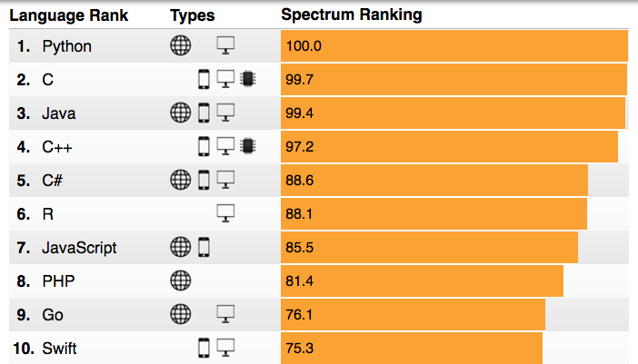
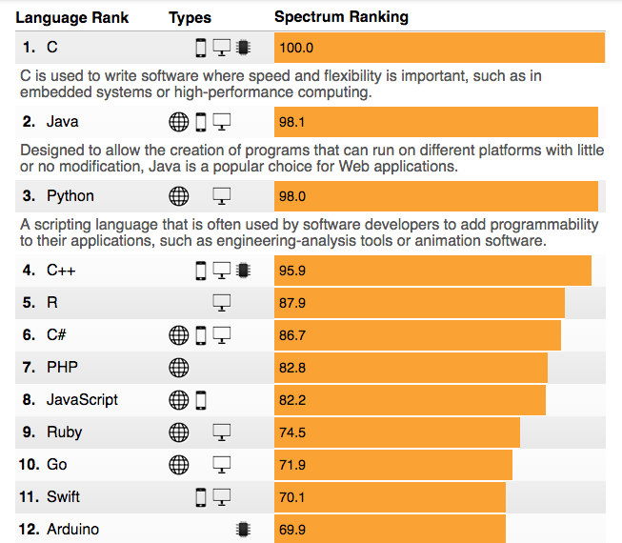
Most Popular Programming Languages 2016-7
What do you think is the most “popular” programming language in use today?
Notes:
C# up, Ruby down …

Slide 5
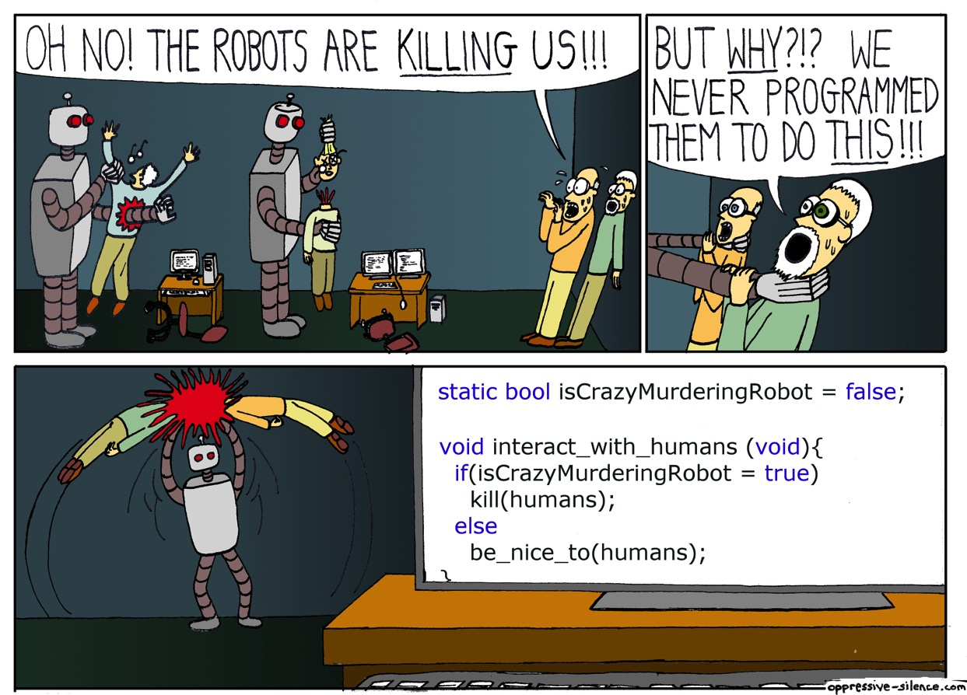
Why You Need to Learn C!

Slide 6
CS61C is NOT really about C Programming
It is about the hardware-software interface
What does the programmer need to know to achieve the highest possible performance
C is close to the underlying hardware, unlike languages like Python and Java!
Allows us to talk about key hardware features in higher level terms
Allows programmer to explicitly harness underlying hardware parallelism for higher performance and power efficiency

Slide 7
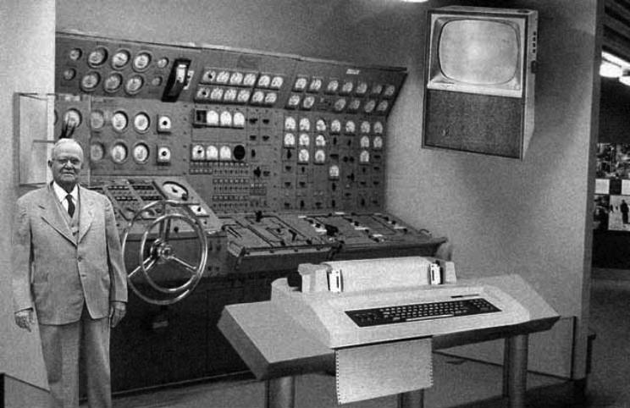
Old School CS61C
Notes:
This image is a fake!
Although the photograph displayed could represent what some people in the early 1950s contemplated a "home computer" might look like (based on the technology of the day), it isn't, as the accompanying text claims, a RAND Corporation illustration from 1954 of a prototype "home computer." The picture is actually an entry submitted to a Fark.com image modification competition, taken from an original photo of a <A HREF="http://home.att.net/~jeff1_satobserve/photo17.htm" TARGET=sub>submarine</A> submarine maneuvering room console found on the U.S. Navy web site, converted to grayscale, and modified to replace a modern display panel and TV screen with pictures of a decades-old teletype/printer and television (as well as to add the gray-suited man to the left-hand side of the photo):

Slide 8
New School CS61C (1/2)
Personal Mobile Devices
Network Edge
Devices

Slide 9
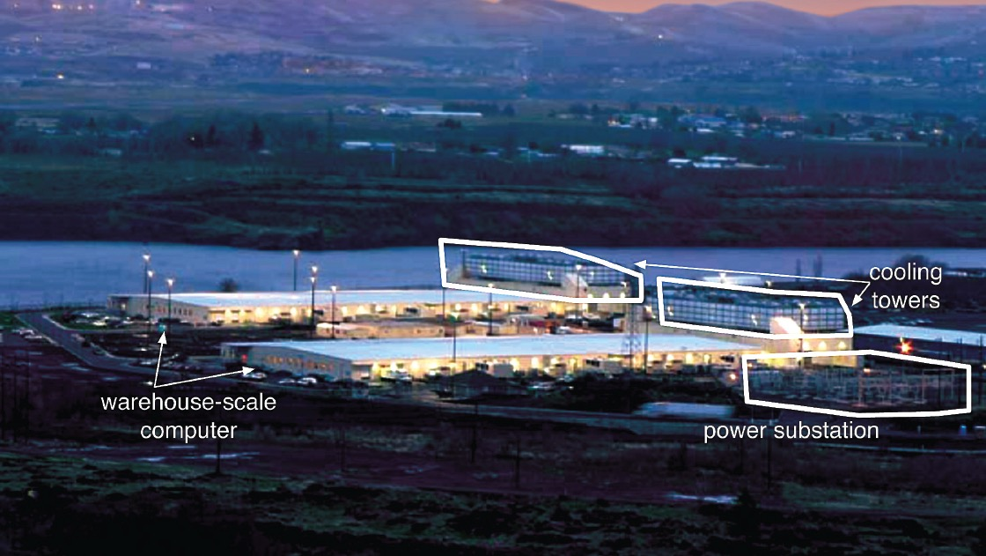
New School CS61C (2/2)

Slide 10
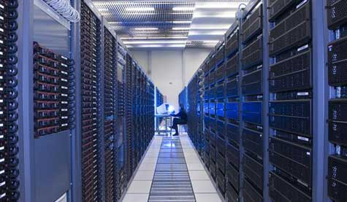
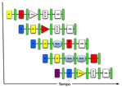
New-School Machine Structures
Software Hardware
Parallel Requests
Assigned to computer
e.g., Search “cats”
Parallel Threads
Assigned to core
e.g., Lookup, Ads
Parallel Instructions
>1 instruction @ one time
e.g., 5 pipelined instructions
Parallel Data
>1 data item @ one time
e.g., Add of 4 pairs of words
Hardware descriptions
All gates functioning in parallel at same time
Warehouse-Scale Computer
Smart Phone
Harness Parallelism &
Achieve High Performance
Computer
Core
…
Core
Memory (Cache)
Input/Output
Core
Instruction Unit(s)
Functional
Unit(s)
A₀+B₀
A₁+B₁
A₂+B₂
A₃+B₃
Main Memory
Logic Gates
10

Slide 11
Agenda
Thinking about Machine Structures
Great Ideas in Computer Architecture
What You Need to Know About This Class
Everything is a Number

Slide 12
Five Great Ideas in Computer Architecture
Abstraction (Layers of Representation/Interpretation)
Moore’s Law (Designing through trends)
Principle of Locality (Memory Hierarchy)
Parallelism
Dependability via Redundancy

Slide 13
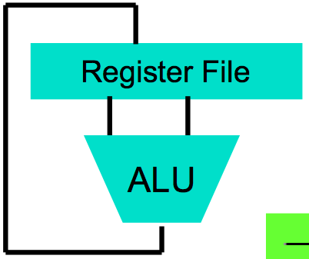
Great Idea #1: Abstraction (Levels of Representation/Interpretation)
High Level Language Program (e.g., C)
temp = v[k];
v[k] = v[k+1];
v[k+1] = temp;
Compiler
Anything can be represented as a number, i.e., data or instructions
lw $t0, 0($2)
lw $t1, 4($2)
sw $t1, 0($2)
sw $t0, 4($2)
Assembly Language Program (e.g., MIPS)
Assembler
0000 1001 1100 0110 1010 1111 0101 1000
1010 1111 0101 1000 0000 1001 1100 0110
1100 0110 1010 1111 0101 1000 0000 1001
0101 1000 0000 1001 1100 0110 1010 1111
Machine Language Program (MIPS)
Machine Interpretation
Hardware Architecture Description (e.g., block diagrams)
Architecture Implementation
Logic Circuit Description (Circuit Schematic Diagrams)

Slide 14
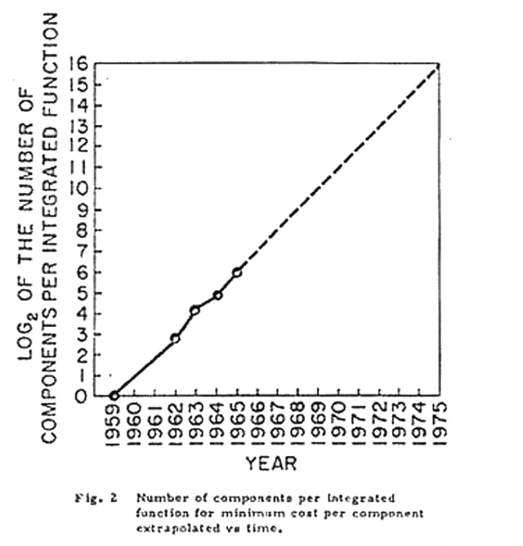
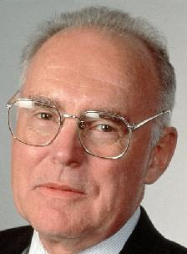
#2: Moore’s Law
Predicts:
2X Transistors / chip every 2 years
Gordon Moore Intel Cofounder B.S. Cal 1950!

Slide 15
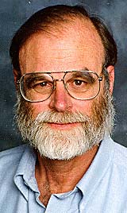
Jim Gray’s Storage Latency Analogy: How Far Away is the Data?
Andromeda
9
10
Tape /Optical
2,000 Years
Robot
10
6
Disk
Pluto
2 Years
Sacramento
1.5 hr
100
Main Memory
Jim Gray Turing Award
B.S. Cal 1966
Ph.D. Cal 1969!
10
On Board Cache
This Campus
10 min
2
On Chip Cache
This Room
1
Registers
My Head
1 min
(ns)
Fall 2017-- Lecture #1

Slide 16
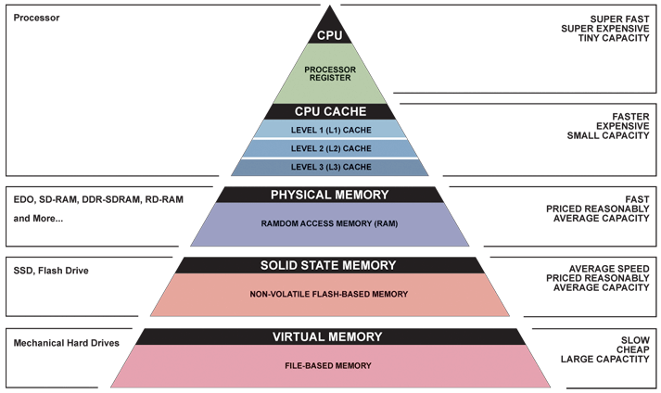
Great Idea #3: Principle of Locality/ Memory Hierarchy
8/29/17

Slide 17
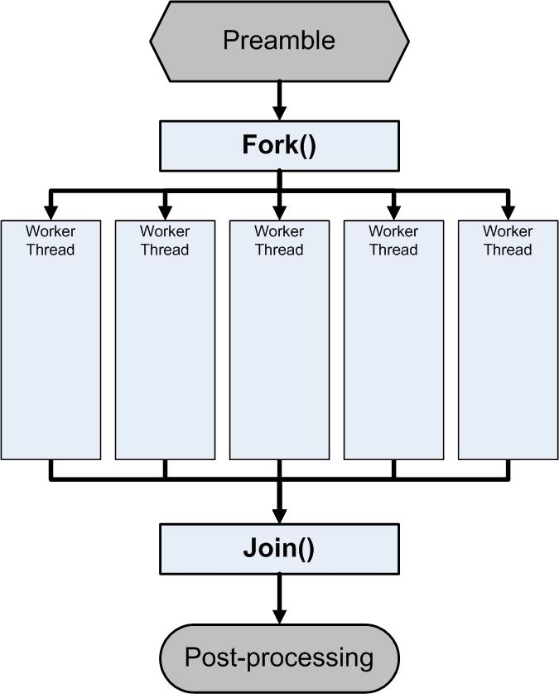
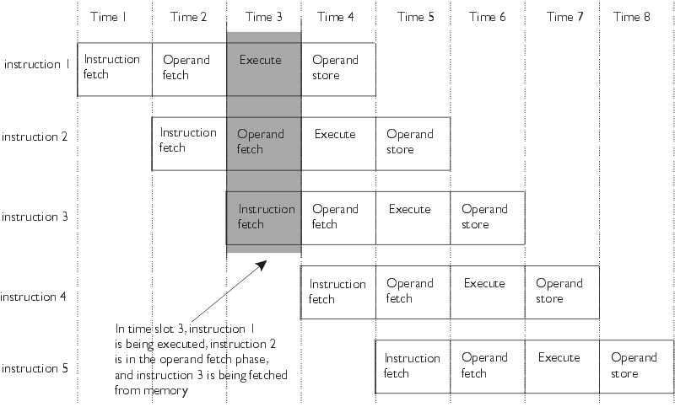
Great Idea #4: Parallelism

Slide 18
Great Idea #5: Dependability via Redundancy
Redundancy so that a failing piece doesn’t make the whole system fail
1+1=2
2 of 3 agree
1+1=2
1+1=2
1+1=1
FAIL!
Increasing transistor density reduces the cost of redundancy

Slide 19
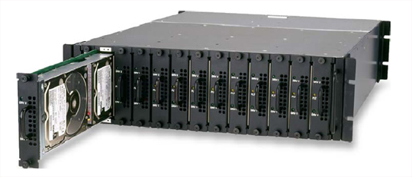
Great Idea #5: Dependability via Redundancy
Applies to everything from datacenters to storage to memory to instructors
Redundant datacenters so that can lose 1 datacenter but Internet service stays online
Redundant disks so that can lose 1 disk but not lose data (Redundant Arrays of Independent Disks/RAID)
Redundant memory bits of so that can lose 1 bit but no data (Error Correcting Code/ECC Memory)

Slide 20
Break!

Slide 21
Why is Architecture Exciting Today?
CPU Speed Flat
CPU Clock Speed +15%/year
Notes:
Goal: fast programs, low cost (power dissipation)
Moore’s law
Past: clock speed increased every year → programs automatically got faster
Today: Clock speed stays constant → only creativity can make programs faster
E.g. parallel processing
61C: learn how to increase speed by over 100x for some algorithms
Combination of architectural innovations and programming innovations

Slide 22
Old Conventional Wisdom
Moore’s Law + Dennard Scaling = faster, cheaper, lower-power general-purpose computers each year
In glory days, 1%/week performance improvement!
Dumb to compete by designing parallel or specialized computers
By time you’ve finished design, next generation of general-purpose will beat you

Slide 23
New Conventional Wisdom
Google TPU2
Specialized Engine for NN training
Deployed in cloud
45 TFLOPS/chip
Serious heatsinks!

Slide 24
Agenda
Thinking about Machine Structures
Great Ideas in Computer Architecture
What You Need to Know About This Class
Everything is a Number

Slide 25
Course Information
Course Web: http://inst.eecs.Berkeley.edu/~cs61c/
Instructors: Krste Asanović and Randy H. Katz
Teaching Staff:
Co-Head TAs: Steven Ho, Steven Chen, and Peijei Li
TAs: Nikhil Athreya, Connor Brennan, Irene Dea, Dylan Dreyer, Julian Early, Derek Feng, Haoan Jing, Tejas Kannan, Daniel Ho, Lisa Lee, Ehimare Okayomon, Srinivasa Pranav, Nicholas Riasanovsky, William Sheu
Tutors:, Ryan Hayes, Anna Li, Sameer Suresh, Morgan Reschenberg, Keyhan Vakil, Nicolas Zoghb
Textbooks: Average 15 pages of reading/week (can rent!)
Patterson & Hennessey, Computer Organization and Design, RISC-V ed.
Kernighan & Ritchie, The C Programming Language, 2nd Edition
Barroso & Holzle, The Datacenter as a Computer, 2nd Edition, FREE!
Piazza:
Every announcement, discussion, clarification happens there!

Slide 26
CS61c House Rules in a Nutshell
Webcast? Yes!
Labs and discussion after NEXT Tuesday’s lecture
Wait listed? Enroll in any available section/lab, swap later
Excused Absences: Let us know by second week
Midterms are in class 26 September and 31 October; Final is 14 December at 7-10 PM
Labs and Projects (4+1 Extra Credit) are partnered
Discussion is Good, but Co-Developing/Sharing/Borrowing Project Code or Circuits is Bad
No Public Repos Please: Don’t Look, Don’t Publish
Join Piazza for more details … see http://inst.eecs.berkeley.edu/~cs61c/fa17/

Slide 27
EPA!
Effort
Attending prof and TA office hours, completing all assignments, turning in HW, doing reading quizzes
Participation
Attending discussion and asking great questions
Altruism
Helping others in lab or on Piazza
EPA! points have the potential to bump students up to the next grade level! (but actual EPA! scores are internal)

Slide 28
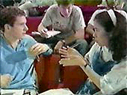
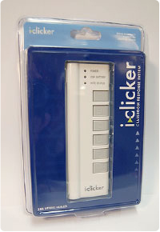
Peer Instruction
Increase real-time learning in lecture, test understanding of concepts vs. details
As complete a “segment” ask multiple-choice question
1-2 minutes to decide yourself
2 minutes in pairs/triples to reach consensus.
Teach others!
2 minute discussion of answers, questions, clarifications
No need for iClickers; we will distribute color cards for you to use!

Slide 29
Collaboration in Black and White
Good Collaboration
High level discussion and brainstorming, stopping short of code snippets
Bad Collaboration
Sitting together and co-writing code, inspecting each other’s code, taking (or giving) code whether in exchange or wholesale copying
This should be obvious, but …
Don’t hire someone to do your assignments
Don’t ask someone outside of the class (a parent, a student from a previous semester, sourceforge) to help you
Don’t use search engines to look for solutions on-line or in someone’s unprotected GitHub (and don’t put your course project solutions in unprotected GitHubs please!)
It is supposed to be your own work after all!

Slide 30
Architecture of a typical Lecture
Full
Fun/News
“And in conclusion…”
Administrivia
Attention
10
35
60
78
90
Time (minutes)

Slide 31
Break!

Slide 32
Agenda
Thinking about Machine Structures
Great Ideas in Computer Architecture
What You Need to Know About This Class
Everything is a Number

Slide 33
Computer Data
Computers represent data as binary values
Unit element: bit
Just two possible values, 0 or 1
Can be efficiently stored/communicated/manipulated in hardware
Use many bits to store more complex information, e.g.
Byte: 8 bits, can represent 2⁸ = 256 different values
Word, e.g. 4 bytes (32 bits) to represent 2³² different values
64-bit floating point numbers
Text files, databases, … (many bytes)
Computer program
Notes:
Bits hold whatever you assign them
No special hardware for storing numbers or text
Even the program is held in the same memory as data (and communicated over the same wires)
Proposed in late 1940ties by John von Neurmann and other contributors, notably …
So common today, it’s hard to think that it could be different
Implemented first in England, in the Manchester Mark I
E.g. big program, small data or vice versa: it does not matter
Question: how does the computer know if a memory location contains a number or a string? Good question! We’ll get to that in the next lecture.
For now, let’s look at how to represent numbers (specifically: integers) with bits.

Slide 34
Binary Number Conversion
Binary → Decimal
Decimal → Binary
1001010_{two} = ?_{ten}
74_{ten} = ?two
Binary Digit | Decimal Value
0 | 0 x 2⁰ = 0
1 | 1 x 2¹ = 2
0 | 0 x 2² = 0
1 | 0 x 2³ = 8
0 | 0 x 2⁴ = 0
0 | 0 x 2⁵ = 0
1 | 1 x 2⁶ = 64
 | Σ = 74_{ten}
Decimal | Binary (odd?)
74 | 0
/2 = 37 | 1
/2 = 18 | 0
/2 = 9 | 1
/2 = 4 | 0
/2 = 2 | 0
/2 = 1 | 1
Collect → | 1001010_{two}
Notes:
Computers work with binary numbers.
Digits are only 0 or 1. Not 0 … 9, like in decimal.
Since we work close to the hardware, we occasionally deal with binary numbers.
Frequently we want to convert between decimal and binary. Many ways to do this. Here I show you a simple approach. If you are familiar with something else, use that.
B->D
Binary number goes in left column. LSB at the top.
Determine decimal value of each digit.
Sum up the individual values.
D->B
Start with decimal value.
Binary digit is 1 if decimal is odd, 0 otherwise.
Divide by 10, ignore fraction. Repeat down to 1.
Collect binary digits. MSB is at bottom.

Slide 35
Hexadecimal
Binary | Hex
0000 | 0
0001 | 1
0010 | 2
0011 | 3
0100 | 4
0101 | 5
0110 | 6
0111 | 7
1000 | 8
1001 | 9
1010 | A
1011 | B
1100 | C
1101 | D
1110 | E
1111 | F
Problem: many digits
e.g. 7643_{ten} = 1110111011011_{two}
Solutions:
Grouping: 1 1101 1101 1011_{two}
Hexadecimal: 1DDB_{hex}
Octal: 1 110 111 011 011_{two}
16733_{oct}
Notes:
Binary numbers have many digits:
In binary, everybody is “rich”!
Computer do not care (nor do they mix up long sequences of bits).
Human’s need “crutches”.
Hexadecimal is most common: map 4 bits to a single character.

Slide 36
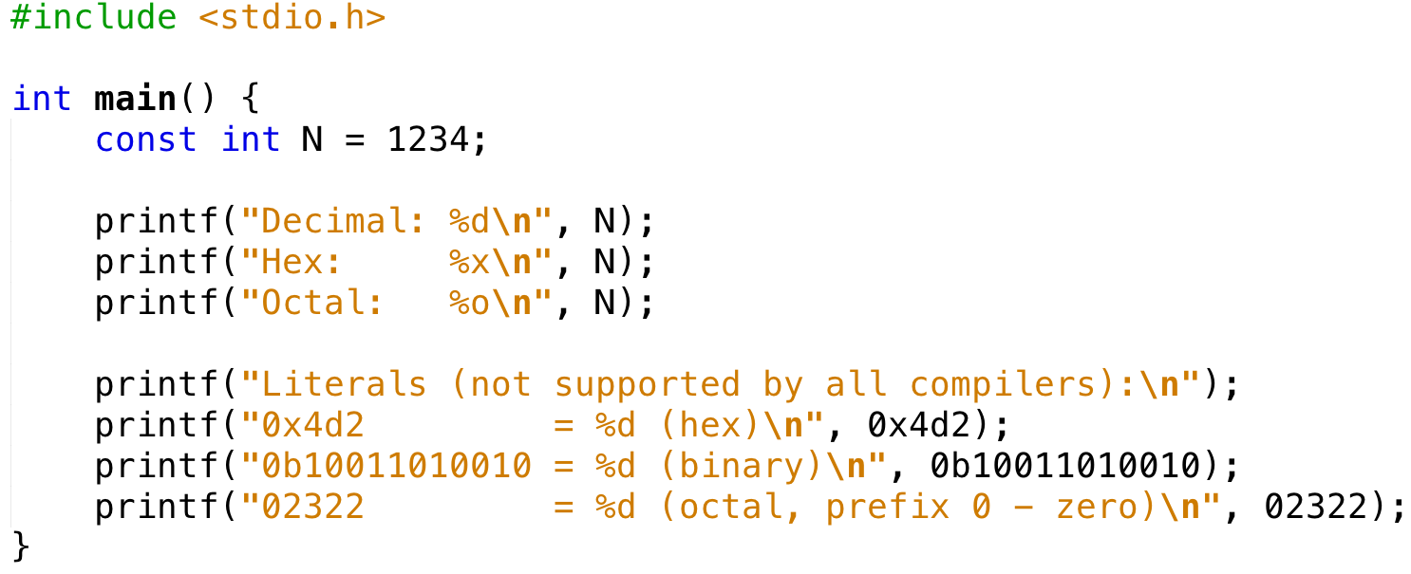
The Computer Knows it, too
Output Decimal: 1234
Hex: 4d2
Octal: 2322
Literals (not supported by all compilers):
0x4d2 = 1234 (hex)
0b10011010010 = 1234 (binary)
02322 = 1234 (octal, prefix 0 - zero)
Notes:
No need to manually convert. Just use the right base when entering literals.
Example is for C.

Slide 37
Large Numbers
Decimal
Binary (IEC)
Suffix | Multiplier | Value
K | 10³ | 1000
M | 10⁶ | 1000,000
G | 10⁹ | 1000,000,000
T | 10¹² | 1000,000,000,000
Suffix | Multiplier | Value
Ki | 2¹⁰ | 1024
Mi | 2²⁰ | 1048,576
Gi | 2³⁰ | 1073,741,824
Ti | 2⁴⁰ | 1099,511,627,776
E.g. 1GiByte disk versus 1GByte disk
Marketing exploits this: 1TB disk → 100GB less than 1TiB
https://en.wikipedia.org/wiki/Byte
Notes:
One km = 1 kilo meters, or just one kilometer
For binary, we often prefer base 2.
Then a kilobyte is 1024 bytes. To make that clear, we use Ki, not just K. A KiBi is 1024 Bytes.
KiBi, MeBi, GiBi, TeBi
E.g. 1GiByte disk contains > 10⁹ bytes.
But some disks are sold with 1GByte capacity, “saving” 73MBytes.
Clever marketing

Slide 38
Signed Integer Representation
Sign & magnitude (8-bit example):
Rules for addition, a + b:
If (a>0 and b>0): add
If (a>0 and b<0): subtract
…
+0, -0 → are they equal? comparator must handle special case!
Cumbersome
”Complicated” hardware: reduced speed / increased power
Is there a better way?
sign | 7-bit magnitude (0 … 127)
Notes:
Familiar decimal notation: just prepend minus sign to signify negative value.
It’s like an extra bit reserved to indicating the sign.
No change to magnitude.
Could do the same with binary numbers.
Unfortunately the result is a nightmare:
rules of addition depend on signs of operands
two representations for zero: + and minus. Cannot just compare bits to determine equality!
It’s possible to build computers that use signed-magnitude integers.
But this adds complexity to the hardware doing arithmetic.
Just like programmer hates slow algorithms, computer architect hates slow hardware.
Complexity reduces speed (maximum frequency at which operations can be performed). Or increases power dissipation. And size. And cost.
Fortunately there is a better way!

Slide 39
4-bit Example
Decimal
Binary
 | 7
+ | -3
 | 4
 | 7
+ | -3 | + 16
 | 4 | + 16
 | 7
+ | 13
 | 4 + 16
 | 0111
+ | 1101
 | 1 0100 | 0100 + 1 0000
Map negative → positive numbers
Example for N=4-bit: -3 → 2⁴ – 3 = 13
“Two’s complement”
No special rules for adding positive and negative numbers
-8 | -7 | … | -1 | 0 | 1 | … | 7
 |  |  |  | 0 | 1 | … | 7 | 8 | 9 | … | 15
+ 2⁴ = 16

Slide 40
Two’s Complement
Signed Decimal | Unsigned Decimal | Binary Two’s Complement
-128 | 128 | 1000 0000
-127 | 129 | 1000 0001
… | … | …
-2 | 254 | 1111 1110
-1 | 255 | 1111 1111
0 | 0 | 0000 0000
1 | 1 | 0000 0001
… | … | ...
127 | 127 | 0111 1111
+256
+0
Note: Most significant bit (MSB) equals sign

Slide 41
Unary Negation (Two’s Complement) 4-bit Example (-8_{ten} … +7_{ten})
Brute Force & Tedious
Clever & Elegant
”largest” 4-bit number + 1
16_{ten}
10000_{two}
15_{ten}
01111_{two}
- 3_{ten}
- 0011_{two}
- 3_{ten}
- 0011_{two}
13_{ten}
1101_{two}
12_{ten}
1100_{two}
invert
+ 1_{ten}
+ 0001_{two}
16_{ten}
10000_{two}
13_{ten}
1101_{two}
- 13_{ten}
- 1101_{two}
3_{ten}
0011_{two}
Notes:
How do we determine the bit pattern of a negative number?
We cannot just flip the MSB!
Turns out it’s very simple.
To go from unsigned to signed, we had to add 2^N. For signed to two’s complement, we subtract from 2^N. Here N=4, hence we subtract from 16.
Of course we can do it also convert the negative two’s complement number back to the corresponding positive value. And get what we started from.
The subtraction is tedious: since all but the MSB are 0, we have to do a lot of “borrowing”.
Let’s try something different.
Subtract from 15, 2^N-1. Now all digits are one and the subtraction is trivial. In fact, in binary it’s just an inversion.
Well, that was easy. Only the result was wrong.
But that’s easily fixed by adding the one we missed by subtracting from 15 instead of 16.
Adding 1 is easy. The result is the same as with the brute force method.
If you build a computer, which approach do you use?

Slide 42
Your Turn
What is the decimal value of the following binary 8-bit 2’s complement number?
1110 0001_{two}
Answer | Value
A | 33_{ten}
B | -31_{ten}
C | 225_{ten}
D | -33_{ten}
E | None of the above
Notes:
-31

Slide 43
Addition 4-bit Example
Unsigned
Signed (Two’s Complement)
3_{ten}
0011_{two}
3_{ten}
0011_{two}
+ 4_{ten}
+ 0100_{two}
+ 4_{ten}
+ 0100_{two}
7_{ten}
0111_{two}
7_{ten}
0111_{two}
3_{ten}
0011_{two}
3_{ten}
0011_{two}
+ 11_{ten}
+ 1011_{two}
+ -5_{ten}
+ 1011_{two}
14_{ten}
1110_{two}
-2_{ten}
1110_{two}
No special rules for two’s complement signed addition
Notes:
Now let’s try addition.
Note there are no special rules for negative numbers.
Everything just comes out right.

Slide 44
Overflow 4-bit Example
Unsigned
Signed (Two’s Complement)
13_{ten}
1101_{two}
-3_{ten}
1101_{two}
+ 14_{ten}
+ 1110_{two}
+ -2_{ten}
+ 1110_{two}
27_{ten}
1 1011_{two}
-5_{ten}
1 1011_{two}
carry-out and overflow
carry-out but no overflow
7_{ten}
0111_{two}
7_{ten}
0111_{two}
+ 1_{ten}
+ 0001_{two}
+ 1_{ten}
+ 0001_{two}
8_{ten}
0 1000_{two}
-8_{ten}
0 1000_{two}
no carry-out and no overflow
no carry-out but overflow
Carry-out → Overflow
Carry-out → Overflow
Notes:
With one caveat: since computer numbers have a finite number of bits,
the results of addition can exceed the maximum number that can be represented.
With only 4 bits, that’s very easy.
Of course, we could just use 8, 16, or even 32 bits to make overflow less likely.
But even with 64 bit numbers, overflow is possible.
Let’s look at a few examples, for signed and unsigned integers. We again stick to just 4 bits to make everything fit on the page and in our heads.
For unsigned numbers it’s easy: the carry-out indicates overflow.
For signed numbers that’s not the case. Actually, it’s not immediately obvious how to detect overflow for addition of two’s complement numbers.

Slide 45
Overflow Detection 4-bit Example
Unsigned
Signed (Two’s Complement)
Carry-out indicates overflow
Overflow if
Signs of operands are equal
AND
Sign of result differs from sign of operands
No overflow when signs of operands differ
Overflow rules depend on operands (signed vs unsigned)
Notes:
A little more investigation shows that the rules are not really complicated …
But we must remember that they are DIFFERENT for unsigned and signed numbers!
Acceptable tradeoff for making addition simple and fast

Slide 46
Sign Extension
Decimal | Binary
 | 4-bit | 8-bit | 32-bit
3_{ten} | 0011_{two} | 0000 0011_{two} | 0000 0000 0000 0011_{two}
-3_{ten} | 1101_{two} | 1111 1101_{two} | 1111 1111 1111 1101_{two}
Why is this relevant?
Assignment differs for signed (above) and unsigned numbers
Compiler knows (from type declaration)
Different assembly instructions for copying signed/unsigned data

Slide 47
Your Turn
Which range of decimals can be expressed with a 6-bit two’s complement number?
Answer | Range
A | -32 … 32
B | -64 … 63
C | -31 … 32
D | -16 … 15
E | -32 … 31

Slide 48
Answer
Which range of decimals can be expressed with a 6-bit two’s complement number?
Answer | Range
A | -32 … 32
B | -64 … 63
C | -31 … 32
D | -16 … 15
E | -32 … 31

Slide 49
And In Conclusion … (1/2)
CS61C:
Higher speed performance + better energy efficiency by leveraging computer architecture:
Strength and weaknesses (e.g. cache)
Performance features (e.g. parallel instructions)
Learn C and assembly facilitate access to machine features
Basis: five great ideas in computer architecture
Abstraction: Layers of Representation/Interpretation
Moore’s Law
Principle of Locality/Memory Hierarchy
Parallelism
Dependability via Redundancy
Performance Measurement and Improvement

Slide 50
And In Conclusion … (2/2)
Everything is a Number!
Collections of bits can store and communicate arbitrary digital data
Even programs are represented by bits
Two’s complement representation avoids special rules for addition of negative numbers

